Slide 1
Programming II
(C Programming Language)
Strings in C
Lecture 15, Monday April 05, 2021
Dr. Ayman ALJARBOUH

Slide 2
Outline
C Programming Strings
Declaring and Initializing Strings
Read a Line of Text
Passing Strings to Functions
Strings and Pointers
String Manipulation Using Library Functions
C Programming Input & Output (I/O)

Slide 3

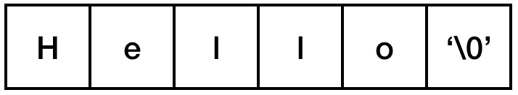
C Programming Strings
A string in C programming language is actually a one-dimensional array of characters which is terminated by a null character '\0'. For example:
The size of the character array containing the string is one more than the number of characters in the string
Following is the memory presentation of above-defined string (i.e. the word “Hello”) in C
You do not place the null character at the end of a string. The C compiler automatically places the '\0' at the end of the string when it initializes the array

Slide 4
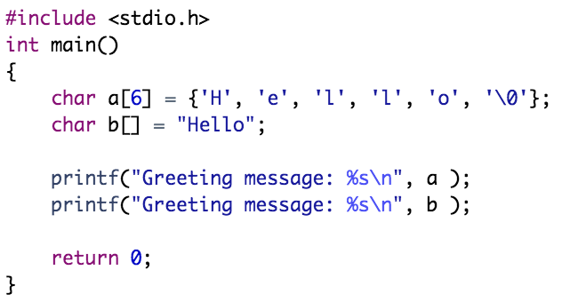
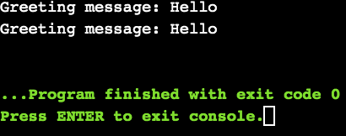
C Programming Strings
Example:

Slide 5
Outline
C Programming Strings
Declaring and Initializing Strings
Read a Line of Text
Passing Strings to Functions
Strings and Pointers
String Manipulation Using Library Functions
C Programming Input & Output (I/O)

Slide 6


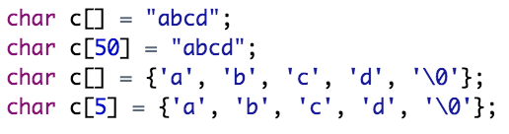
Declaring and Initializing Strings
The syntax of declaring a string is as following:
For example:
Here we declare a string variable s of 5 characters
You can initialize strings by many ways. Following is an example of string initialization

Slide 7
Outline
C Programming Strings
Declaring and Initializing Strings
Read a Line of Text
Passing Strings to Functions
Strings and Pointers
String Manipulation Using Library Functions
C Programming Input & Output (I/O)

Slide 8
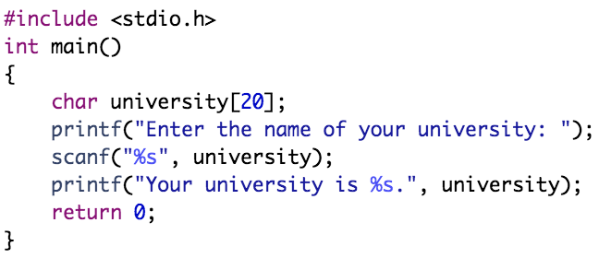
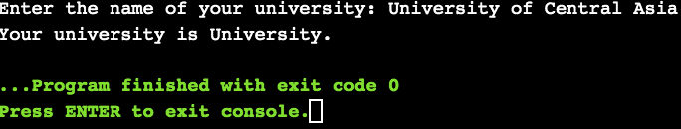
Read a Line of Text
You can use the scanf() function to read a string. The scanf() function reads the sequence of characters until it encounters whitespace
Example:
Even though “University of Central Asia” was entered in the above program, only “University” was stored in the university string. It's because there was a space after “University”.

Slide 9
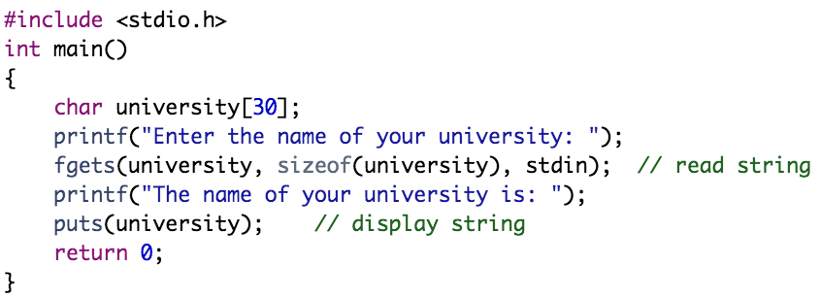
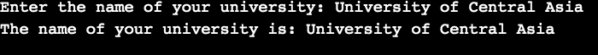
Read a Line of Text
You can use the fgets() function to read a line of string. And, you can use puts() to display the string
Example:
We have used fgets() function to read a string from the user

Slide 10
Read a Line of Text
You can use the fgets() function to read a line of string. And, you can use puts() to display the string
Example:
The sizeof() is related to the maximum number of characters to be copied into the string variable, including the null-character

Slide 11
Read a Line of Text
You can use the fgets() function to read a line of string. And, you can use puts() to display the string
Example:
The stdin is the related to the file object that identifies an input stream. Here we use stdin as argument to read from the standard input

Slide 12
Read a Line of Text
You can use the fgets() function to read a line of string. And, you can use puts() to display the string
Example:
To print the string, we have used the puts() function

Slide 13
Read a Line of Text
You can use the fgets() function to read a line of string. And, you can use puts() to display the string
Example:
Note: Also you can use the gets() function to take input from the user. However, it is removed from the C standard. It's because gets() allows you to input any length of characters. Hence, there might be a buffer overflow

Slide 14
Outline
C Programming Strings
Declaring and Initializing Strings
Read a Line of Text
Passing Strings to Functions
Strings and Pointers
String Manipulation Using Library Functions
C Programming Input & Output (I/O)

Slide 15
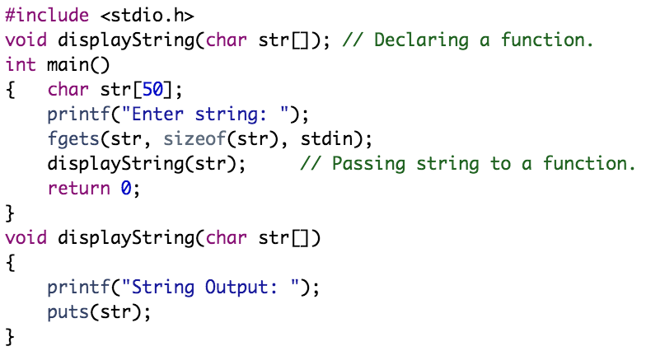
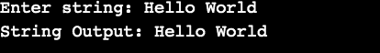
Passing Strings to Functions
Strings can be passed to a function in a similar way as arrays. Following is an example about passing a string to a function
Example:

Slide 16
Outline
C Programming Strings
Declaring and Initializing Strings
Read a Line of Text
Passing Strings to Functions
Strings and Pointers
String Manipulation Using Library Functions
C Programming Input & Output (I/O)

Slide 17
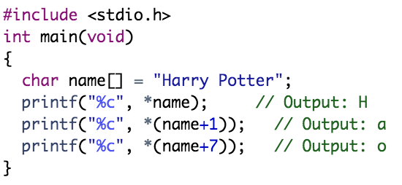
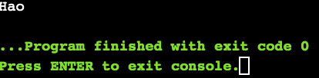
Strings and Pointers
Similar like arrays, string names are "decayed" to pointers. Hence, you can use pointers to manipulate elements of the string
Example:

Slide 18
Outline
C Programming Strings
Declaring and Initializing Strings
Read a Line of Text
Passing Strings to Functions
Strings and Pointers
String Manipulation Using Library Functions
C Programming Input & Output (I/O)

Slide 19
String Manipulation Using Library Functions
C supports a number of string handling functions in the standard library "string.h”. String handling functions are listed below:
Function | Purpose
strlen() | This function returns the length of the string. Example: strlen(name);. This will return the length of the string stored in the variable name[].
strcat() | This function concatenates two strings. Example: strcat(name1,name2);. This will concatenate the strings stored in the variables name1[] and name2[] in the order in which it is written.
strcpy() | This function copies the value of the second string to the first string. Example: strcpy(name1,name2);. This will copy the string in name2[] to the variable name1[].
strlwr() | It changes all the characters of the string to lower case. Example: strlwr(name);. It shall convert the whole string stored in the variable name[] to lowercase.
strupr() | It changes all the characters of the string to upper case. Example: strupr(name);. It shall convert the whole string stored in the variable name[] to uppercase.

Slide 20
String Manipulation Using Library Functions
C supports a large number of string handling functions in the standard library "string.h”. String handling functions are listed below:
Function | Purpose
strchr() | It returns the location or the pointer of the first occurrence of a character in a string. Example: strchr(name,ch);. It returns the location of the first occurrence of the character in ch in the string name[]. It returns null if the character is not found.
strstr() | It returns the location or the pointer of the first occurrence of one string in another. Example: strstr(name1,name2);. It returns the location of the first occurrence of name2[] in name1[]. It returns null if the string is not found.

Slide 21
String Manipulation Using Library Functions
C supports a large number of string handling functions in the standard library "string.h”. String handling functions are listed below:
Function | Purpose
strcmp() | It compares two strings lexicographically, means it starts comparison character by character starting from the first character until the characters in both strings are equal or a NULL character is encountered. To determine which string comes first, compare corresponding characters of the two strings from left to right. The first character where the two strings differ determines which string comes first. All uppercase letters come before lower case letters. If two letters are the same case, then alphabetic order is used to compare them. Example: strcmp(name1,name2);. This compares the string in name1[] with the string in name2[]. It returns 0 if the strings are same. It returns a value less than 0 if name1[]<name2[]. Otherwise, it returns a value greater than 0.

Slide 22
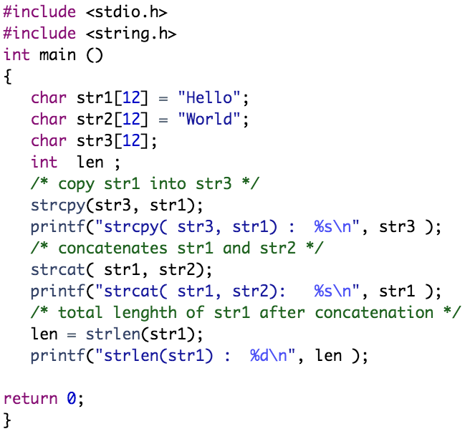
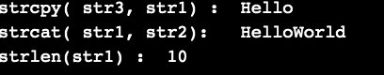
Example:

Slide 23
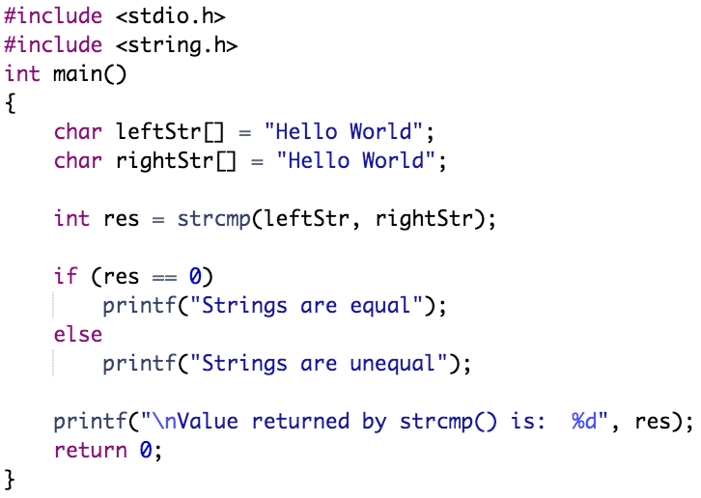
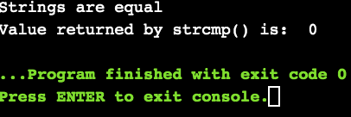
Example:

Slide 24
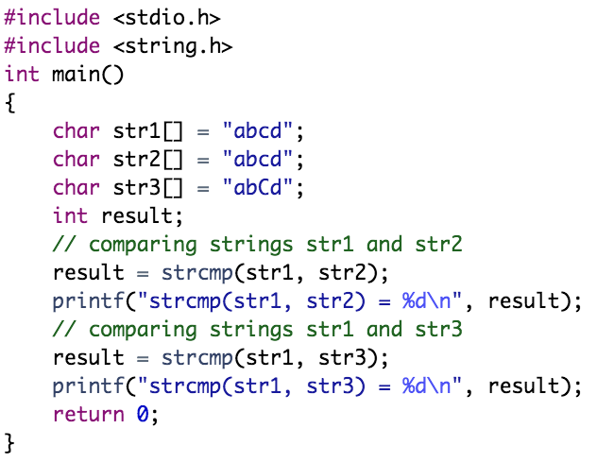
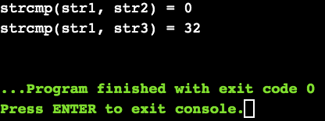
Example:
In the above code, the first unmatched character between string str1 and str3 is third character. The ASCII value of 'c' is 99 and the ASCII value of 'C' is 67. Hence, when strings str1 and str3 are compared, the return value is 99 – 67 = 32. When strings str1 and str2 are compared, the result is 0 because both strings are identical.

Slide 25
Outline
C Programming Strings
Declaring and Initializing Strings
Read a Line of Text
Passing Strings to Functions
Strings and Pointers
String Manipulation Using Library Functions
C Programming Input & Output (I/O)

Slide 26
C Programming Input & Output (I/O)
C programming language treats all the devices as files
The following three files are automatically opened when a program executes to provide access to the keyboard and screen
Standard File | File Pointer | Device
Standard input | stdin | Keyboard
Standard output | stdout | Screen
Standard error | stderr | Screen

Slide 27
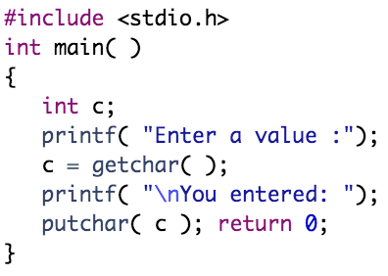
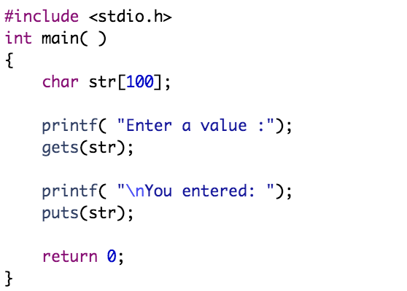
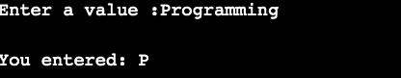
The getchar() and putchar() Functions
The getchar() and putchar() are declared in the header file stdio.h. The function getchar() reads only single character at a time. The function putchar() puts the passed character on the screen and returns the same character
Example:

Slide 28
The gets() & puts() Functions
The gets() and puts() are declared in the header file stdio.h. Both the functions are involved in the input/output operations of the strings
The gets() function enables the user to enter some characters followed by the enter key. The gets() allows the user to enter the space-separated strings. It returns the string entered by the user
The puts() function is used to print the string on the console which is previously read by using gets() or scanf() function. Since, it prints an additional newline character with the string, which moves the cursor to the new line on the console

Slide 29
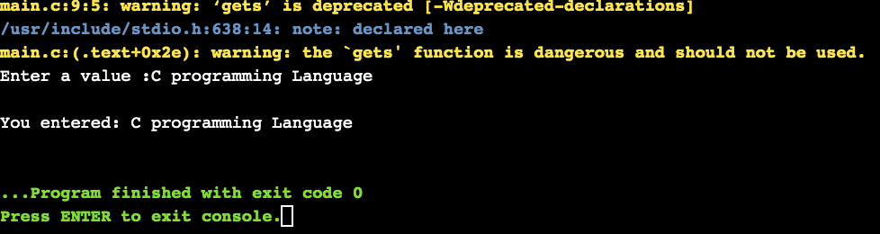
The gets() & puts() Functions
Example:
Note: The gets()function is risky to use since it doesn't perform any array bound checking and keep reading the characters until the new line (enter) is encountered. It suffers from buffer overflow, which can be avoided by using fgets(). The fgets() makes sure that not more than the maximum limit of characters are read.

Slide 30
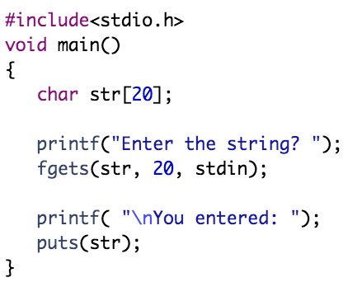
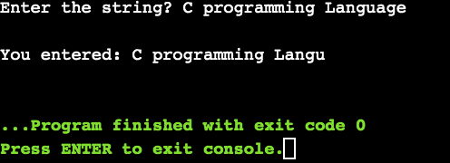
The gets() & puts() Functions
Example:

Slide 31
The scanf() & printf() Functions
The scanf() and printf() are declared in the header file stdio.h
Both the functions are involved in the input/output operations
When using scanf() and printf() functions, the user can specify the format %s, %d, %c, %f, etc., to print or read strings, integer, character or float, respectively
Note: When using scanf() function for string input from the user, you can also use the format specifier %[^\n]. It means scan all characters in the entered string till \n or an enter key

Slide 32
The scanf() & printf() Functions
The scanf() and printf() are declared in the header file stdio.h
Both the functions are involved in the input/output operations
When using scanf() and printf() functions, the user can specify the format %s, %d, %c, %f, etc., to print or read strings, integer, character or float, respectively
For example, scanf("%[^\n]",line);. This statement will read user input until enter is pressed or a newline character \n is added, and store it into a variable named line

Slide 33
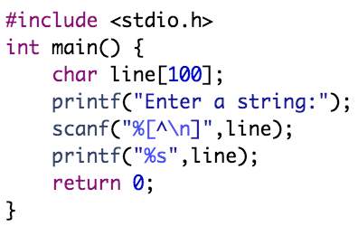
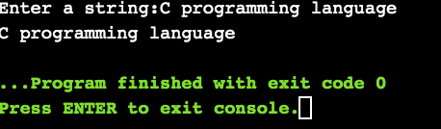
The scanf() & printf() Functions
Example:

Slide 34
Practical Exercises
Write and Compile the following C programs:
Program 1:

Slide 35
Practical Exercises
Write and Compile the following C programs:
Program 2:

Slide 36
Practical Exercises
Write and Compile the following C programs:
Program 3:

Slide 37
Practical Exercises
Write and Compile the following C programs:
Program 4:

Slide 38
Practical Exercises
Write and Compile the following C programs:
Program 5:

Slide 39
Practical Exercises
Write and Compile the following C programs:
Program 6:

Slide 40
Practical Exercises
Write and Compile the following C programs:
Program 7:

